Slide 1
Social Studies
Essential Standards Resources
Some of us recently attended staff development and learned of new resources.

Slide 2
Social Studies Curriculum Maps & Units
Teachers, working with DPI staff in workshops on unit planning, have begun collaborative communities hosted by Intel Engage. To get to these resources join the Intel community. Then, use the browse tab and go to groups. Search for NC Concept-based units, then ask to join each group. There are 3 groups.
http://engage.intel.com
Notes:
Terrific resource and very easy to use.

Slide 3
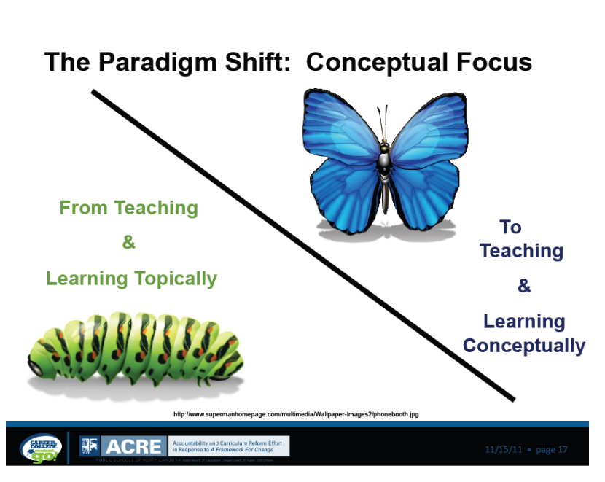
Notes:
It is important to think about teaching students concepts, not just facts!

Slide 4
One way to think about unit plans for Social Studies
Notes:
When planning a social studies unit consider all strands of the social studies standards.

Slide 5
Notes:
Ideas from each strand that may be helpful when planning a unit of study.

Slide 6
Align the VERBS!
In order to teach the standards well, we must use the verbs in the standards and in Revised Bloom’s to plan lessons and assessments.
It is not enough for students to know information, we should ask students to use the information to compare, organize, evaluate…(pick a verb).
Notes:
This is make more sense when you complete the Revised Bloom’s module.

Slide 7
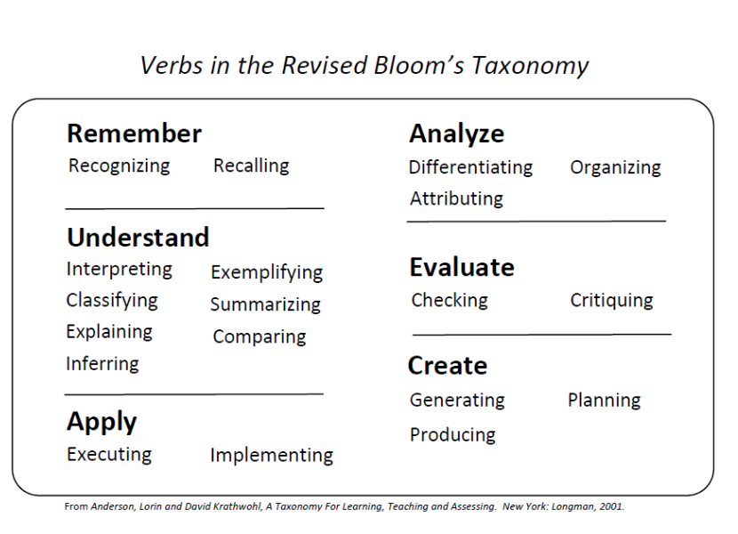

Slide 8
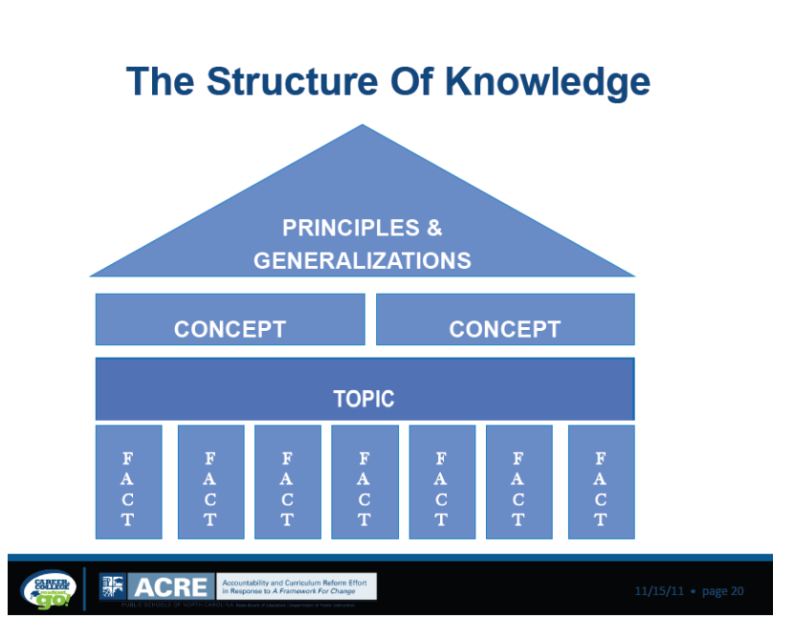
Another helpful visual

